Slide 1

Introduction to Play Framework
Andrew Zysk

Slide 2
What is Play?
Web Application Framework
Open Source
Written in Scala
Also usable from Java
Model-View-Controller Architectural Pattern
RESTful - performance, reliability, scalability via reusable components
Integrated Unit Testing

Slide 3

Model-View-Controller (MVC) Architecture
Model - retrieves and stores data
View - outputs information of any kind to the user, based on changes to the model
Controller - accepts input from the user and passes it to the Model as a command

Slide 4
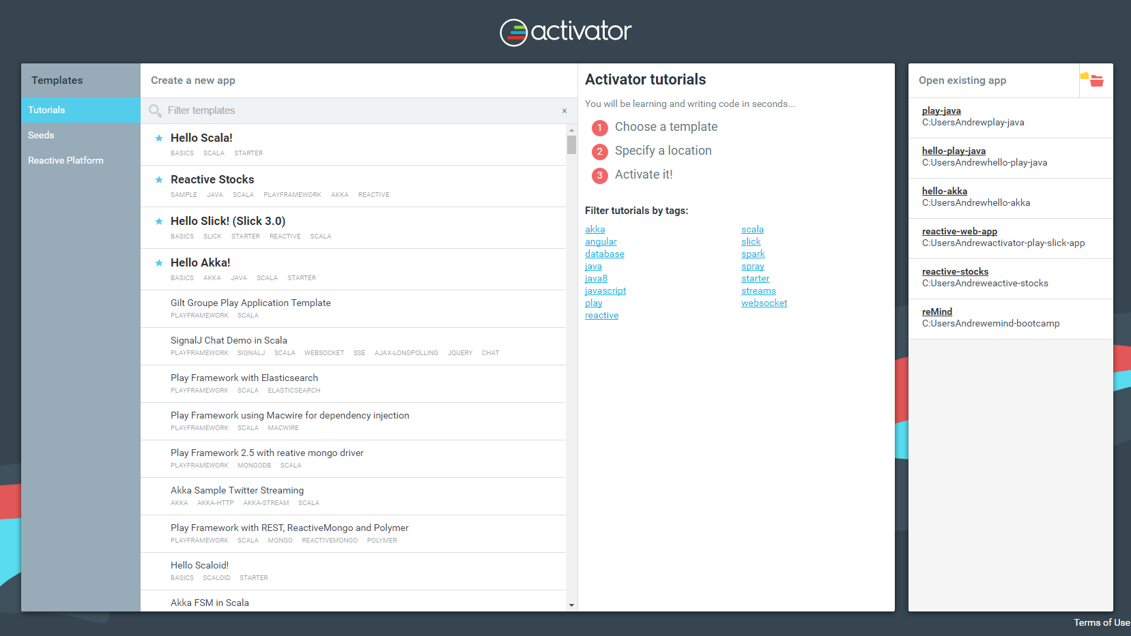
Templates and Activator UI
“activator” in the command line to start a Play project
“activator ui” opens UI in your browser
Templates and Tutorials available

Slide 5
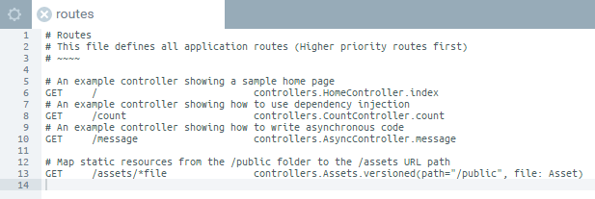
Routes
“Skeleton” of the application
Defines all application routes
Each route calls a method in a Controller
Activator localhost:8888
Application localhost:9000

Slide 6
Thank You

